Slide 1
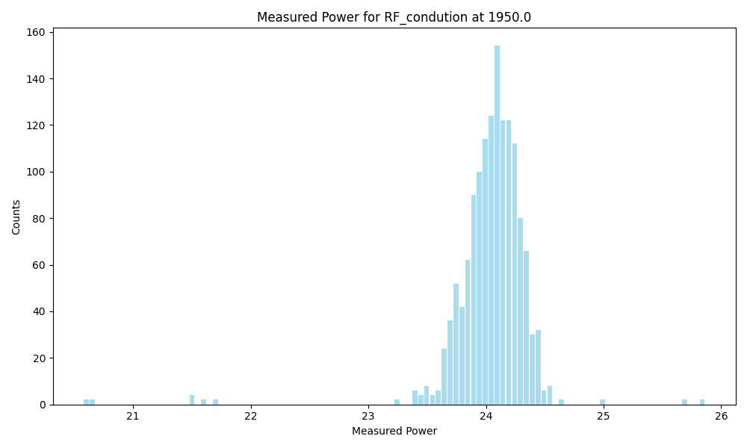
Frequency | 1950.0
Count | 1426
Mean | 24.04
Std | 0.35
Min | 20.57819
Max | 25.86422

Slide 2
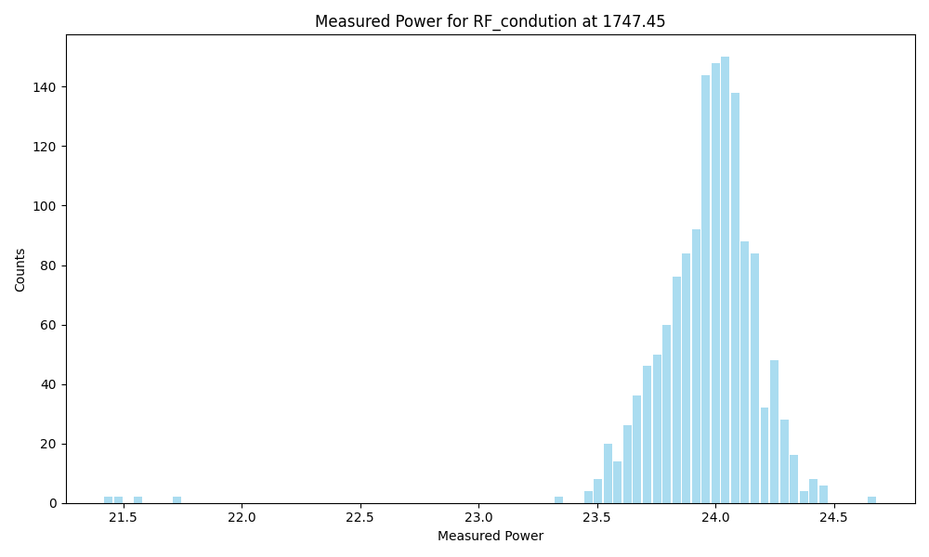
Frequency | 1747.45
Count | 1422
Mean | 23.96
Std | 0.26
Min | 21.41619
Max | 24.68214

Slide 3
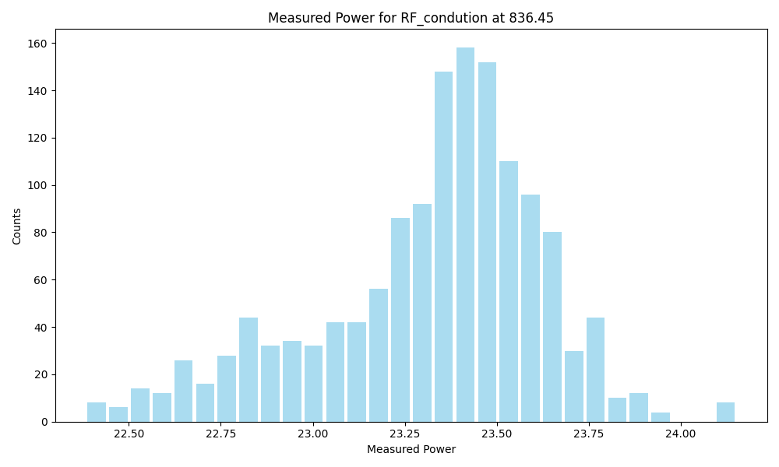
Frequency | 836.45
Count | 1422
Mean | 23.32
Std | 0.31
Min | 22.38327
Max | 24.15143

Slide 4
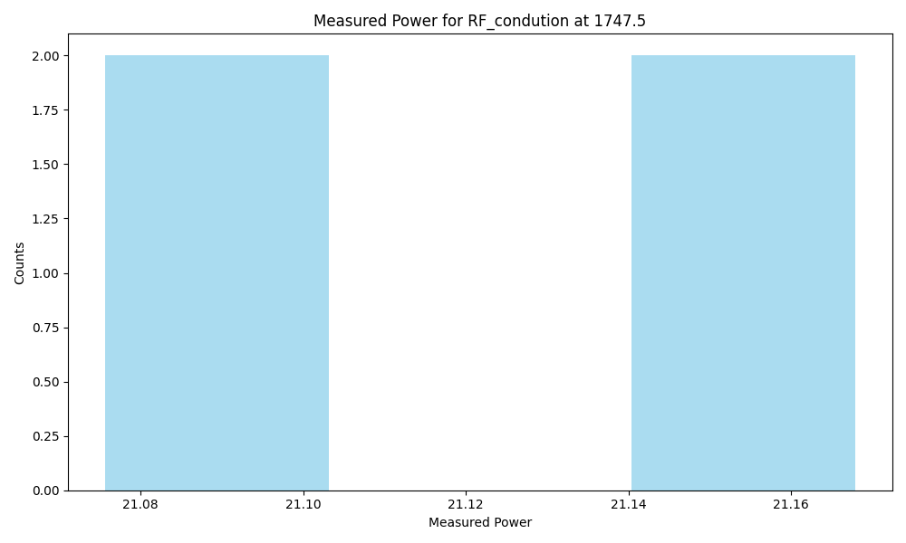
Frequency | 1747.5
Count | 4
Mean | 21.12
Std | 0.05
Min | 21.07325
Max | 21.1703

Slide 5
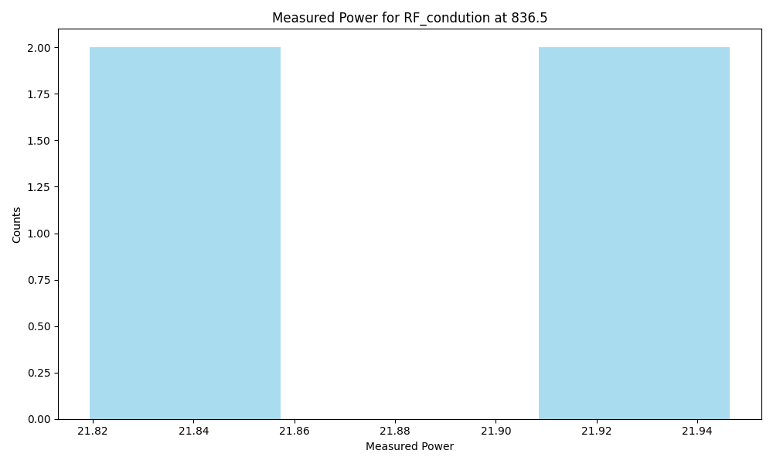
Frequency | 836.5
Count | 4
Mean | 21.88
Std | 0.07
Min | 21.81611
Max | 21.94969

